Slide 1
Getting the Most out of Kingdom Academy

Slide 2
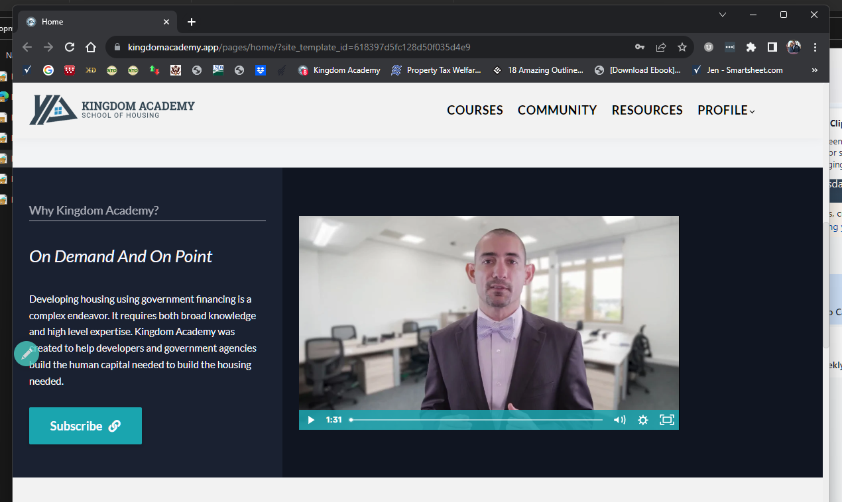
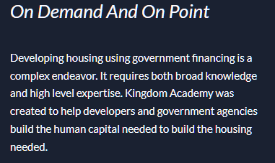
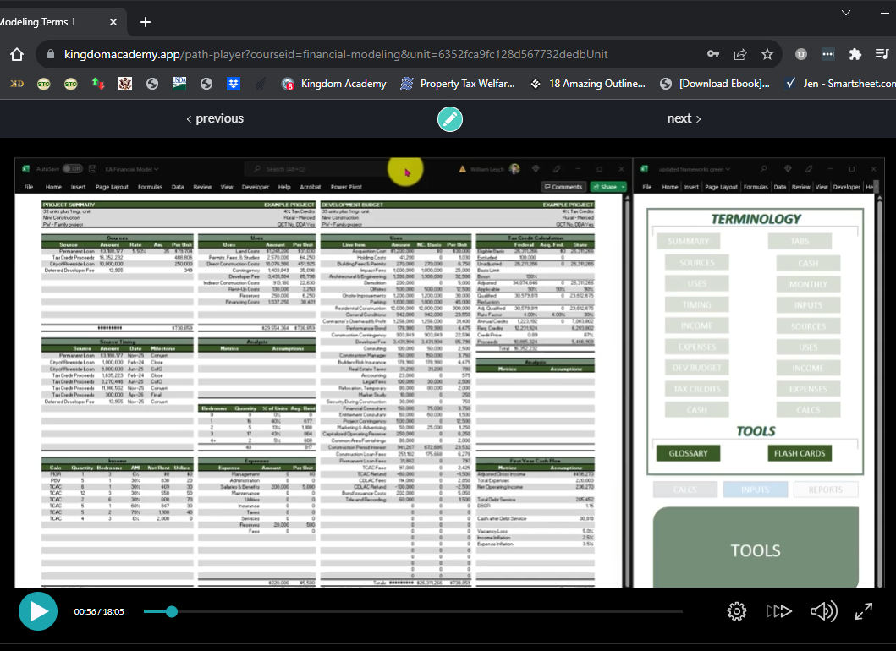
What is “Kingdom Academy”
Online school
Self-paced
Educational videos
Affordable housing
http://www.KingdomAcademy.app

Slide 3
Kingdom Academy
(80) Hours of training
(24) Paid subscriber organizations
(240) Paid users
http://www.KingdomAcademy.app

Slide 4
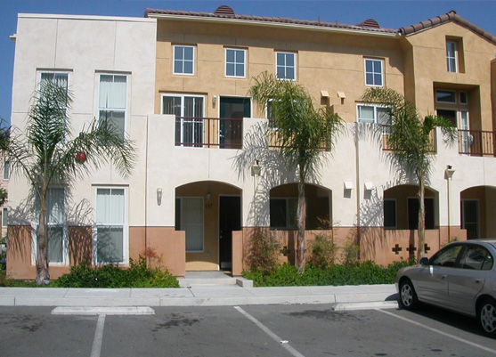
Notable Subscribers: Nonprofit Developers
http://www.KingdomAcademy.app

Slide 5
Notable Subscribers: For-profit Developers
http://www.KingdomAcademy.app

Slide 6
Notable Subscribers: Government Agencies
http://www.KingdomAcademy.app

Slide 7
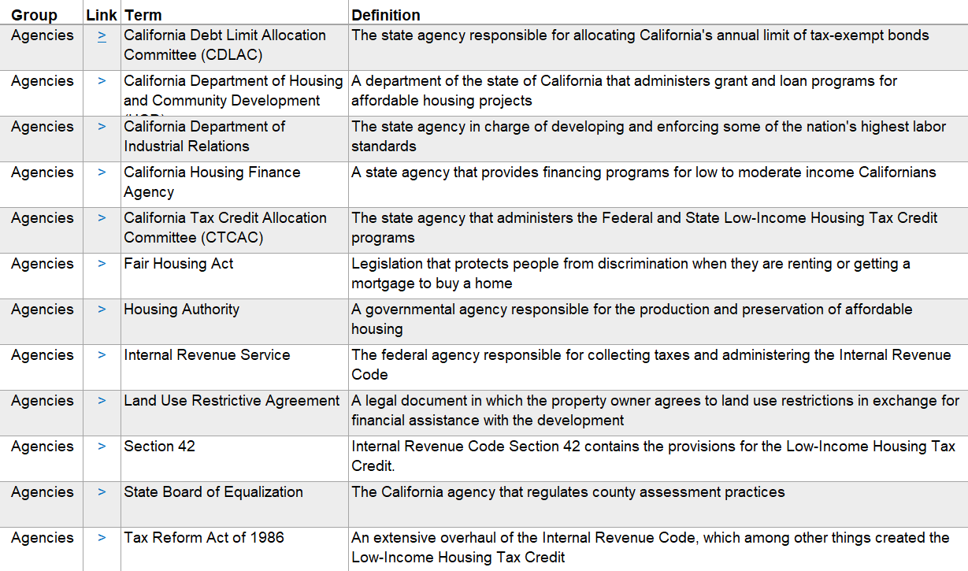
Housing Glossary
Glossary
(175) Affordable housing terms/acronyms
Searchable index with link to the website
Development
Glossary Index. xlsx
Finance
Modeling
Simulations
CA LIHTC

Slide 8
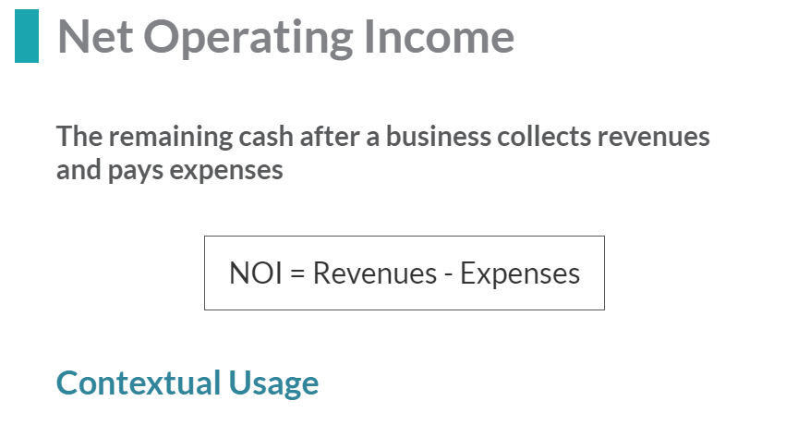
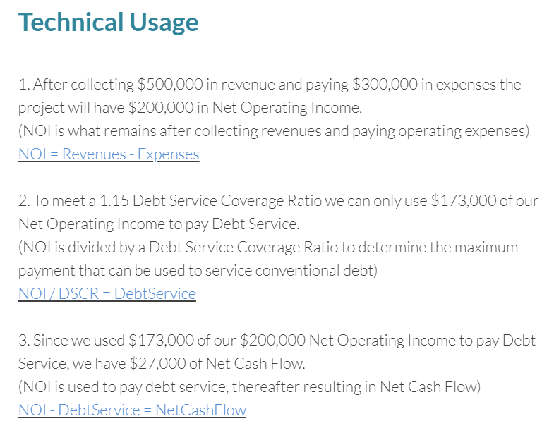
Housing Glossary
Glossary
Development
Finance
Modeling
Simulations
CA LIHTC

Slide 9
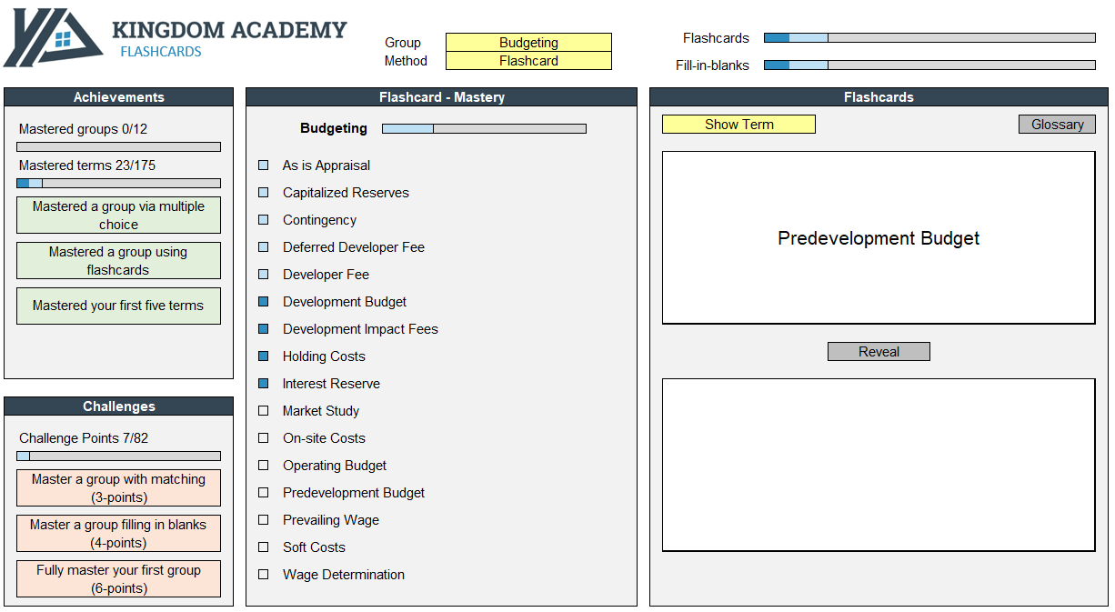
Housing Glossary
Glossary
Flashcard training aid
Multiple Choice – Matching – Fill in the blanks
Development
Finance
Modeling
Simulations
CA LIHTC

Slide 10
Housing Glossary
Glossary
(175) Affordable housing terms/acronyms
Searchable index
Flash card training aid
Development
Finance
Great onboarding tool
Teaches niche industry lingo
Modeling
Simulations
CA LIHTC

Slide 11
AH Development Course
Glossary
(60) Hours of on-demand training
Videos – Activities – Discussion agendas
Development
Finance
Modeling
Simulations
CA LIHTC

Slide 12
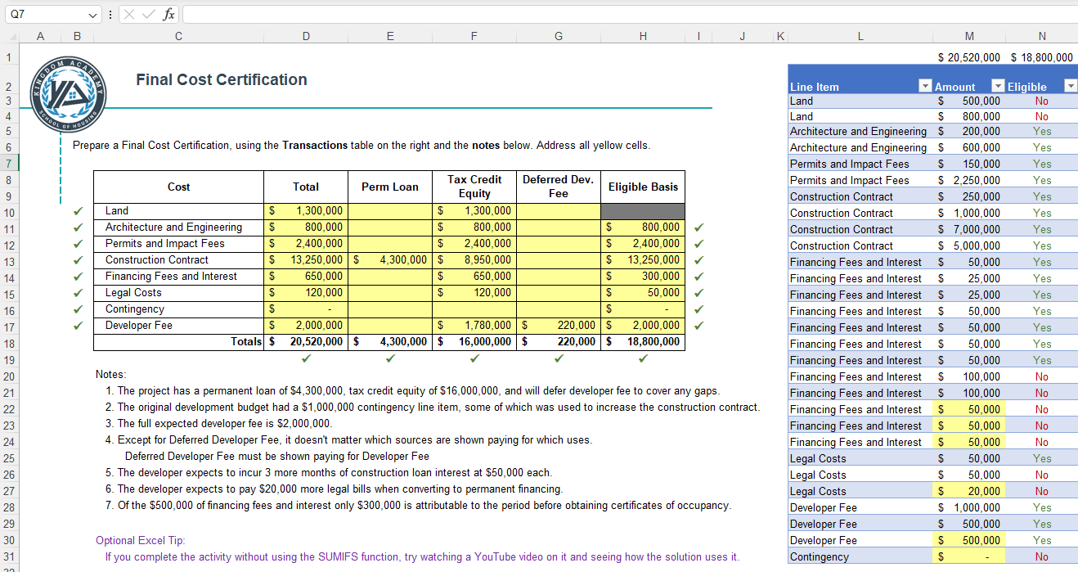
AH Development Course
Glossary
Quizzes and activities for assessment
Development
Finance
Final Cost Certification Activity. xlsx
Modeling
Simulations
CA LIHTC

Slide 13
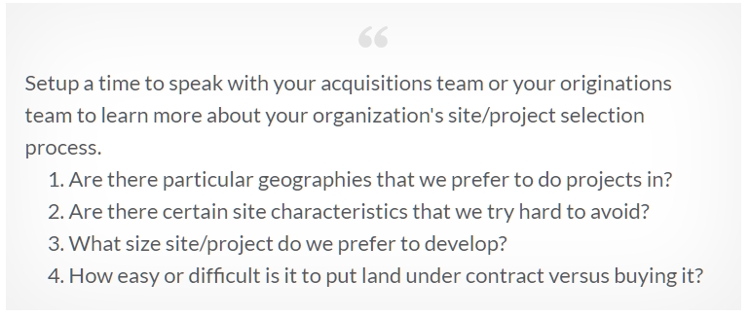
AH Development Course
Glossary
Discussion prompts facilitate context
Development
Finance
Modeling
Simulations
CA LIHTC

Slide 14
AH Development Course
Glossary
Self-paced Industry-specific training
(40+) On-demand videos
(20+) Excel-based activities
(30+) Discussion prompts
Development
Finance

Slide 15
Financial Modeling Course
Glossary
(25) Hours of proforma training
Development
Finance
Modeling
Simulations
CA LIHTC
Understand
Run Models

Slide 16
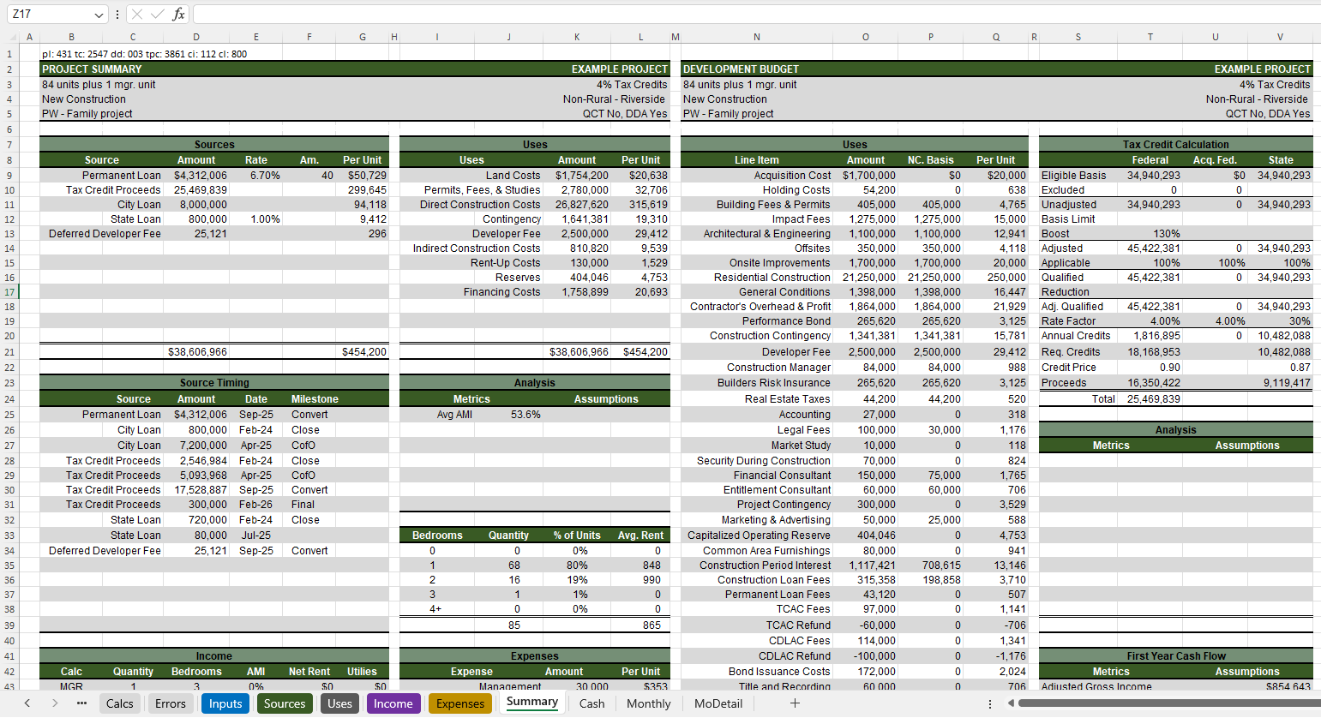
Financial Modeling Course
Glossary
Functional proforma for affordable housing deals
Development
Finance
Affordable Housing Financial Model. xlsx
Modeling
Simulations
CA LIHTC

Slide 17
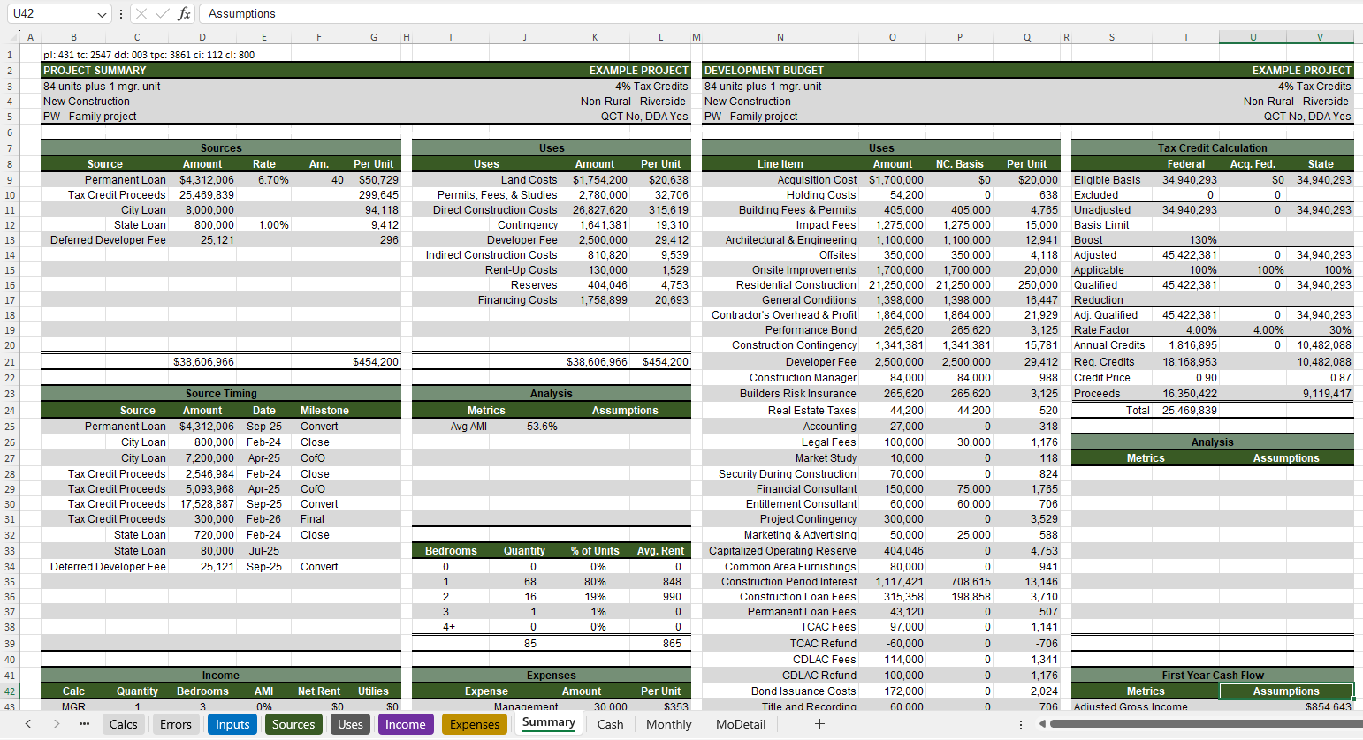

Slide 18
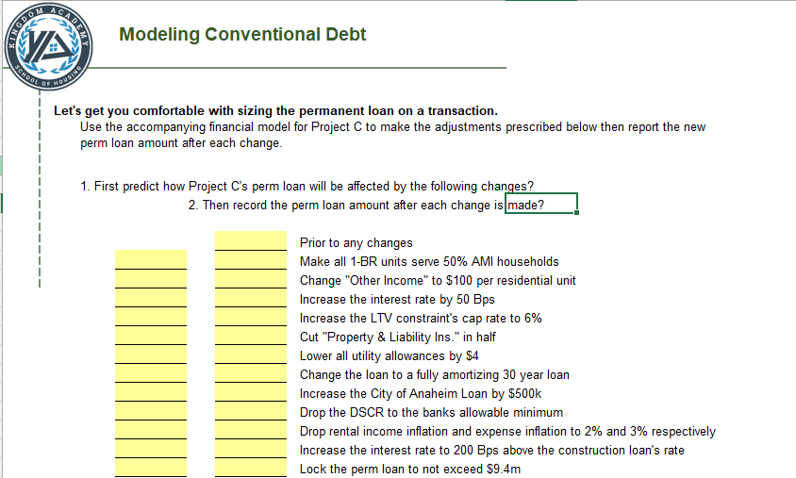
Financial Modeling Course
Glossary
(10) Modeling activities
(5) Modeling tests with solution videos
(12) Discussion agendas to gain context
Development
Finance
Modeling
Simulations
CA LIHTC

Slide 19
Competition Simulations
Glossary
Competitive award simulations
TCAC 9% Rounds – CDLAC Bond Rounds – HCD Super NOFA
(available soon after applicant lists are released)
Development
Finance
Modeling
Simulations
CA LIHTC

Slide 20
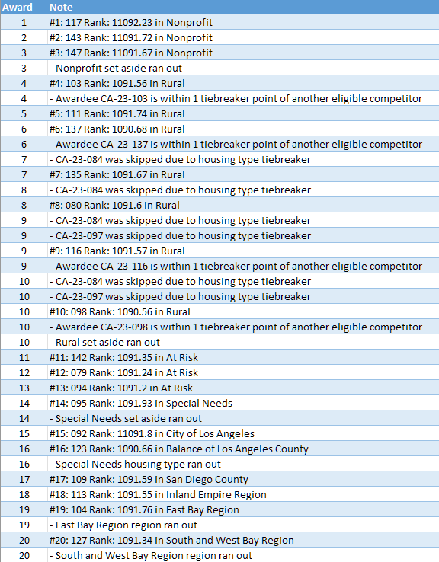
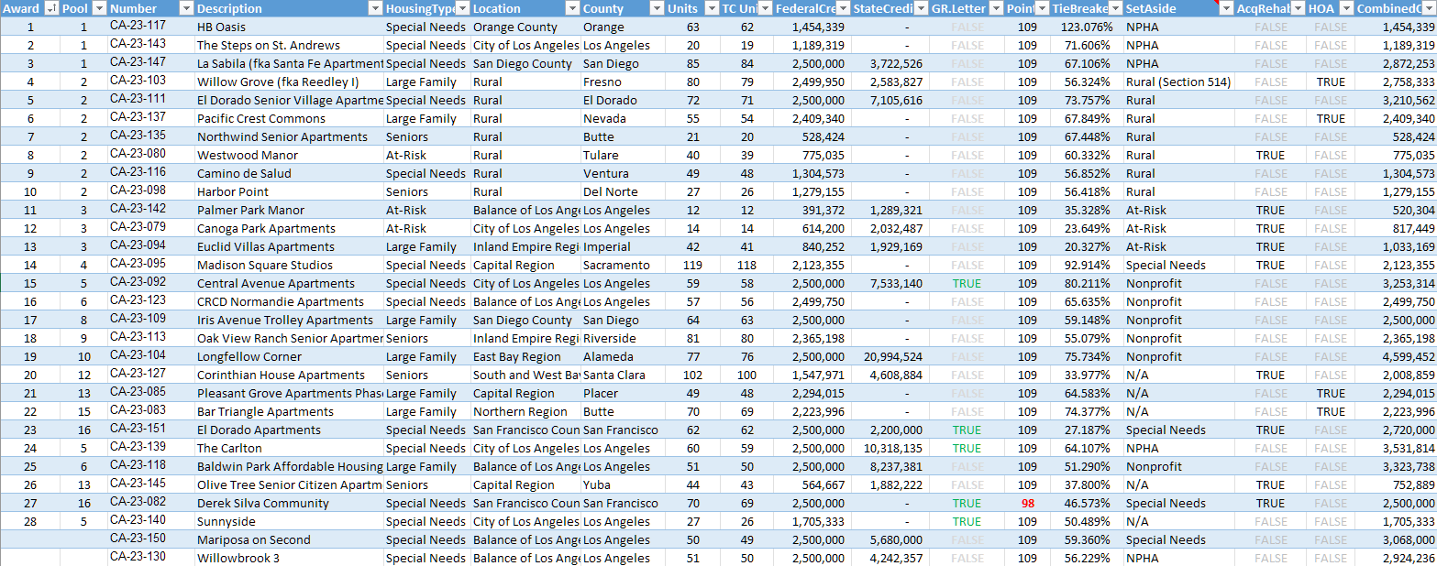
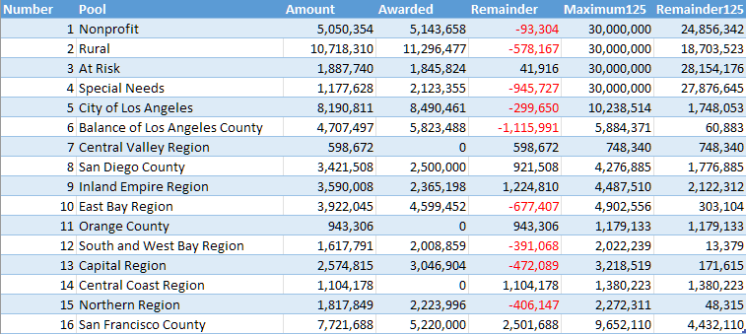
Competition Simulations
Glossary
Open-source fully-programmed award simulators
Simulates which applicants will be awarded (assuming no projects are disqualified)
Development
Simulation Log
Simulations end up being 90% - 95% accurate after projects get reviewed and self-scores are corrected
Finance
Modeling
Applicant List with Award Results
Simulations
Pool Usage
CA LIHTC

Slide 21
Competition Simulations
Glossary
The log provides insights about:
Why a project got skipped
When a housing type goal runs out
When a regional target is met
Development
Simulation Log
Finance
Modeling
Reading the “play-by-play” helps you understand the actual award process
Simulations
CA LIHTC

Slide 22
Competition Simulations
Glossary
The pool analysis provides insights about:
What resources will carryover to the next round
Which pools were undersubscribed
Exactly how many resources can be awarded therein
Development
Finance
Modeling
Simulations
Pool Usage
CA LIHTC

Slide 23
Competition Simulations
Glossary
The award results sheds light on:
Will my project get awarded
What scores were required to win
Which pools are more competitive
How do awardees differ from non-awarded projects
Was the such-n-such priority determinative
How much pent-up demand is there in a given pool
What was the highest score of the first looser
Development
Finance
Modeling
Simulations
Applicant List with Award Results
CA LIHTC

Slide 24
Competition Simulations
While not 100% accurate, these simulations are instructive about what the state is awarding and what the state is likely to award in the future
Glossary
Development
Finance
Modeling
Applicant List with Award Results
Simulations
CA LIHTC

Slide 25
Kingdom Academy (coming 1/1/2024)
California LIHTC Developments
Glossary
Development
A collaborative (40-hour) course
Taught by industry experts
Going deep into topics
Addressing key CA nuances
Finance
Modeling
Simulations
CA LIHTC

Slide 26
Covering Topics On
Market Studies
Relocation Plans
TCAC Placed In Service Apps
TCAC Lowest Income Points
TCAC site amenities

Slide 27
Covering Topics On
Agency debt products
TCAC E-App sources
Bond sale structures
Bridge financing
Josh Hamilton Senior Vice President, Lending

Slide 28
Covering Topics On
Partnership negotiations
Partnership structure
LIHTC overview & eligibility
Set-aside election & income averaging
Certificating state credits

Slide 29
Covering Topics On
QRRP program overview
CDLAC regulation structure
CDLAC set-asides and apportionments
9% competitive structure
Completing Attachment 40
Ben Barker, Registered Municipal Advisor

Slide 30
Covering Topics On
Chris Thompson, CPA
AUDIT PRINCIPAL
Eligible basis certifications
General Partner experience
Cost certifications
The 50% test
Developer fee limits
Bond private placements
Matt Knipprath, Director

Slide 31
Covering Topics On
Chris Thompson, CPA
AUDIT PRINCIPAL
Partner
Value engineered sustainability
Sustainable building methods
Year-15 considerations
Managing legal fees
Dissecting the AIA Construction Contract
Gary
Downs

Slide 32
Covering Topics On
TCAC Appraisal requirements
Rent comparability studies
Operating expenses
Cash flow underwriting
TCAC Additional Threshold Requirements
Jay Wortmann, MAI
Partner
Peter Barker, President

Slide 33
http://www.KingdomAcademy.app
Glossary
Development
Finance
Modeling
Simulations
CA LIHTC
Glossary
Development
Finance
Modeling
Simulations
Thanks to our collaborators for making this all free!

