Slide 1
Federal Policy Update
CCAH – Fall 2023

Slide 2
Meet your new Speaker

Slide 3
Past & Pending Deadlines before Congress
Sept. 30th
FY 2024 Budget – CR extended to Nov. 17
Farm Bill – Expired
FAA Reauthorization – CR Extended to Dec. 31
Nov. 17th
Current CR expires

Slide 4
So What’s Up with a Tax Bill?
In this corner….
Republicans Democrats
R&D Tax Credit Child Tax Credit
Shared Priorities
LIHTC
Business Credits

Slide 5
Again, What’s Up with a Tax Bill?

Slide 6
What else shall we discuss?
- Will there be a shutdown?
- What about those new CRA regs?
- Can we talk insurance?

Slide 7
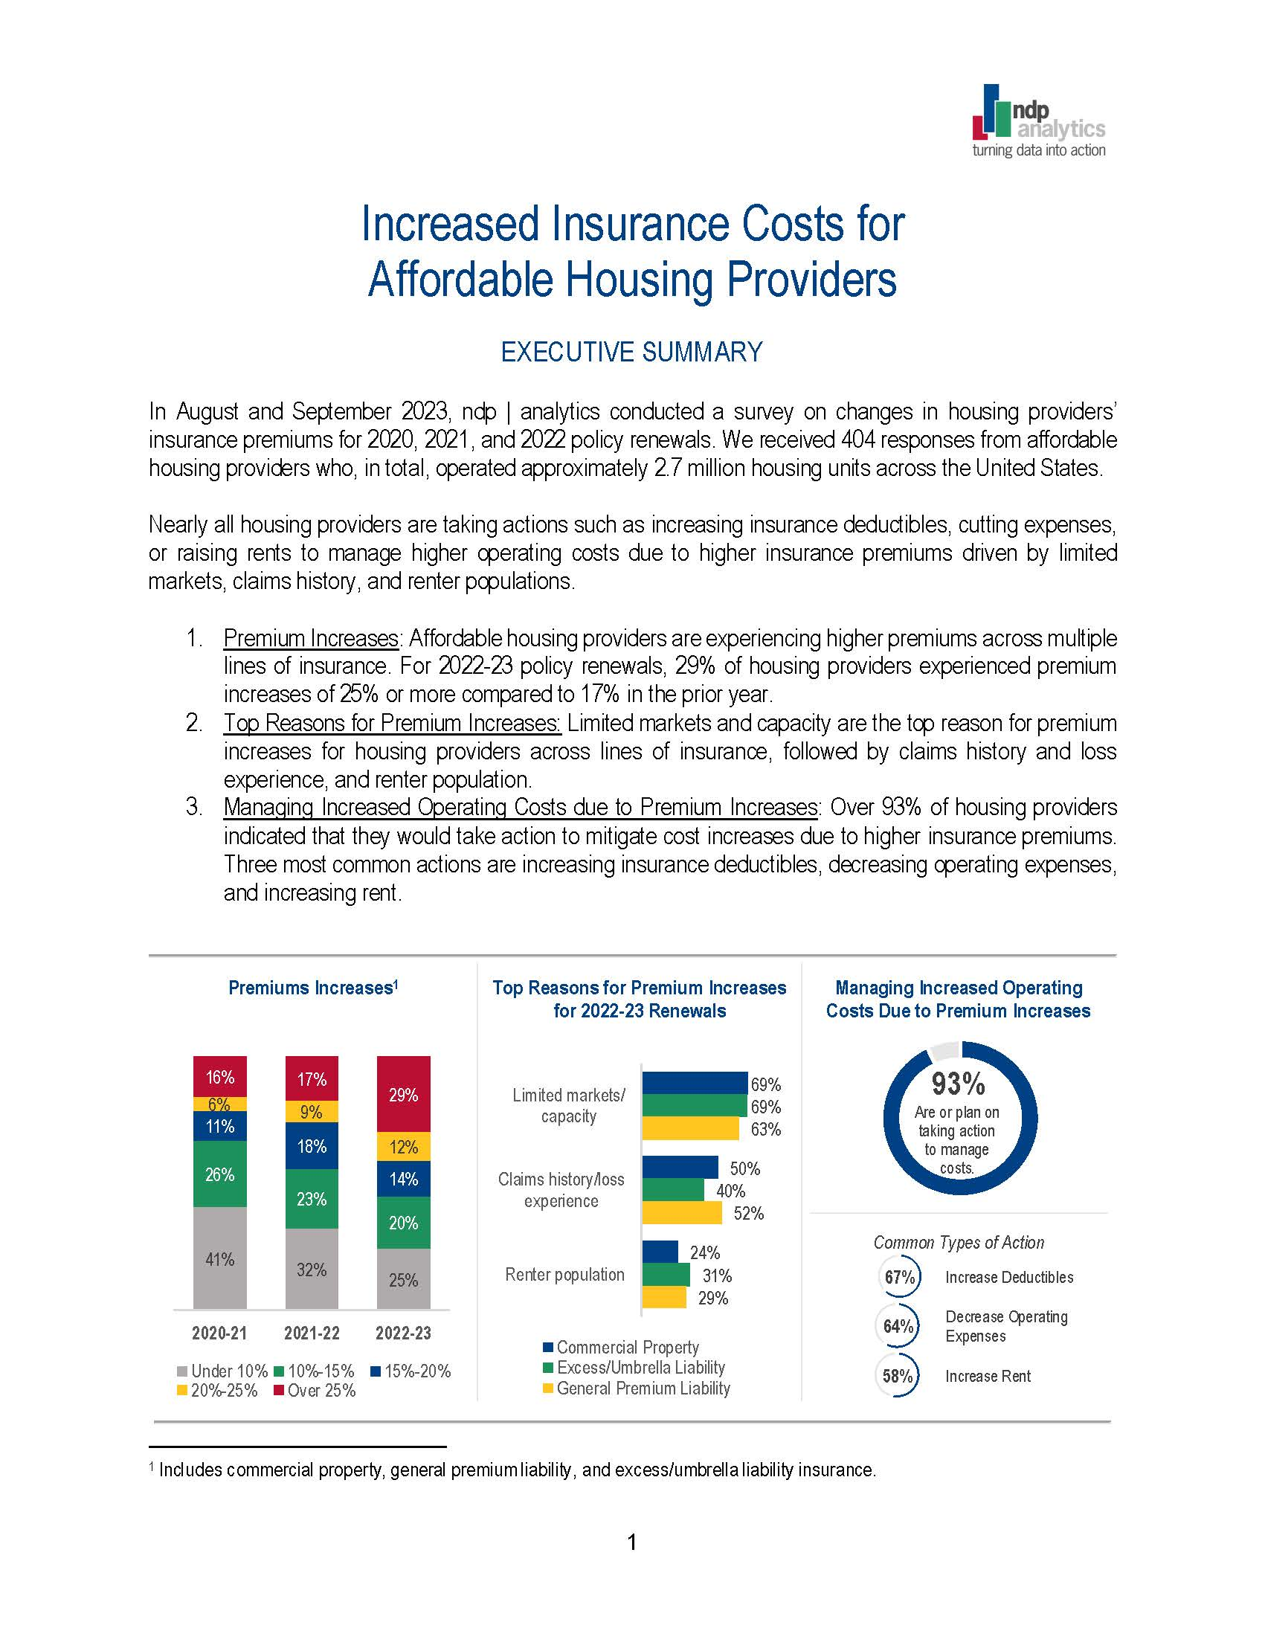

Slide 8
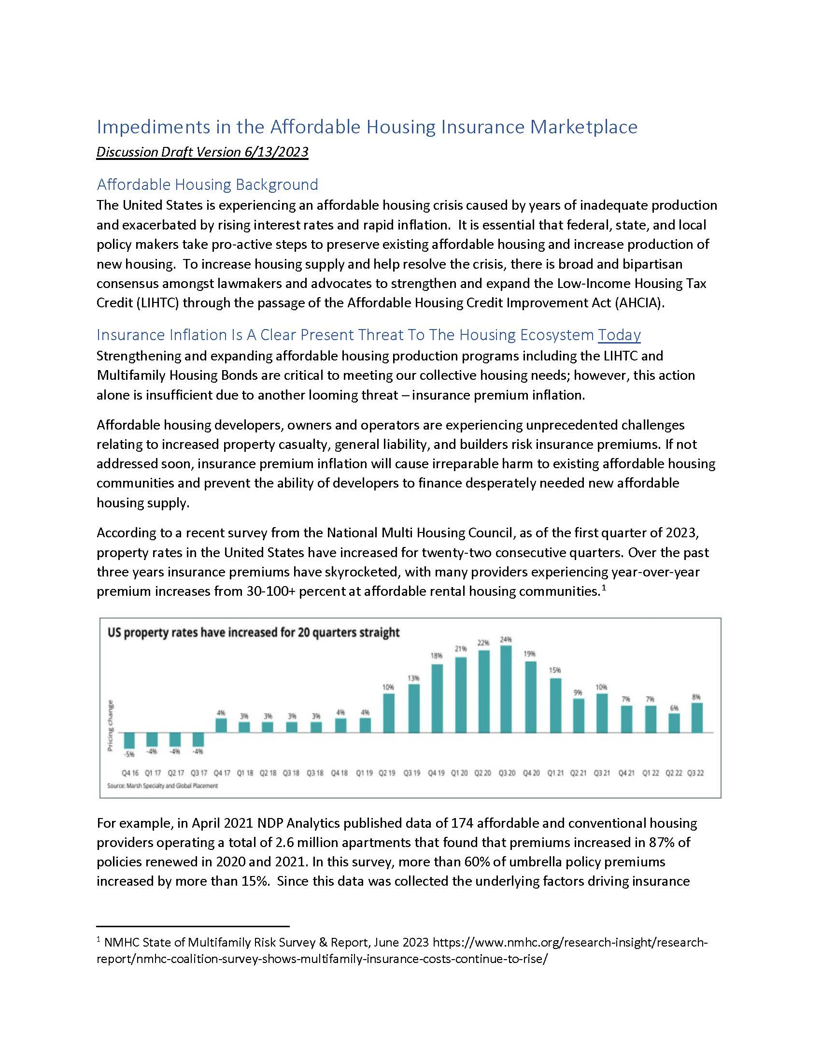

Slide 9
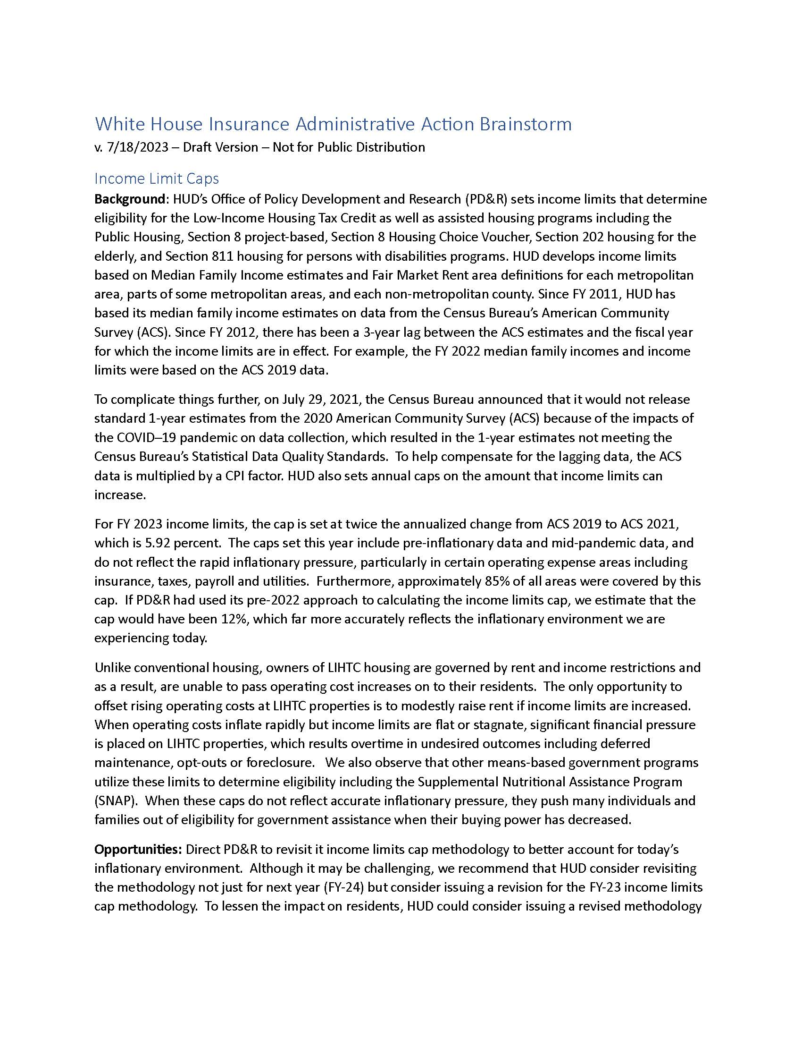

Slide 10
Thank You
Bob Moss & David Gasson
MG Housing Strategies
Bmoss@mghousingstrategies.com
dsgasson@mghousingstrategies.com

